Slide 1
More Than A Profession
Rachel Tricarico
Becoming an Emergency Medical Technician
Penn State Hazleton
Cas100 Speech Communication
October 9, 2009

Slide 2
The Value of Life
What is the value of Life?
“I don't want to get to the end of my life and find that I lived just the length of it. I want to have lived the width of it as well.”
~Diane Ackerman~

Slide 3
Being an EMT
http://www.youtube.com/watch?v=ZIkEf2Wu9B4
Overview
The Value of saving a Life (CPR)
The Training
My Experience
Conclusion

Slide 4
The Value of Saving a Life
Being an EMT one is required to learn skills that help you be able to save a life. The most important skill that you should learn for your everyday life are CPR.
CPR Video –
http://www.youtube.com/watch?v=zqzwsilwGG4
Call 9ll
Check Breathing
Blow 2 breaths
Pump 30 times
Check breathing and Repeat

Slide 5
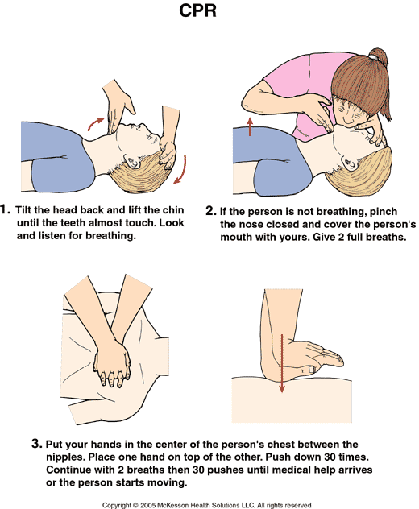
The Value of Saving a Life

Slide 6
The Training
The skill of Cardio Pulmonary Resuscitation is a needed skills but training as a EMT gives you such a skill set that you can handle any situation no matter what happens.
First take CPR Class usually free
Then take a EMT-Basic class at a local Hospital or Medical Training Center

Slide 7
My Experience
Before and After getting your certification you will get a lot of on the job and on field experience as an EMT.
http://www.youtube.com/watch?v=9CTiNciIF6Y

Slide 8
Conclusion
Now that you know the main aspects that go into being an EMT you know that there is more to the medical system that the people that work in the hospital.

Slide 9
What is the Value of Saving a Life……

Slide 10
References
The American National Red Cross."Cpr, First Aid and AED" RedCross.org . The American National Red Cross, 2009. Web. <http://www.redcross.org/portal/site/en/ menuitem.53fabf6cc033f17a2b1ecfbf43181aa0/?vgnextoid=42eebd7df52bb110VgnVCM10000089f0870aRCRD&vgnextfmt=default>.
American Heart Association. " Heimlich Maneuver." www.Americanheart.org. N.p., n.d. Web.<http://www.americanheart.org/presenter.jhtml?identifier=4605>. Education Portal. EducationPortal.com . N.p., n.d. Web. <http://education-portal.com/articles/ EMT_Professions%3A_Overview_of_Educational_Requirements.html>. West orange First Aid Squad. "Who we are." wofas.org. N.p., n.d. Web. <http://www.wofas.org>. Monster.com "EMT." YouTube.com. N.p., n.d. Web. <http://www.youtube.com/ watch?v=QQAwBmog08s>. CBS NEws. High School EMTs CBS News . YouTube.com. N.p., n.d. Web. <http://www.youtube.com/watch?v=ZIkEf2Wu9B4>. Paramedic and EMT Dedication Video. YouTube.com N.p., n.d. Web. http://www.youtube.com/watch?v=9CTiNciIF6Y
Ems Fire How to save a life. Youtube.com N.p., n.d. Web. http://www.youtube.com/watch?v=85eleClPzJM

